Slide 1

Life Expectancy: Unpacking the Global Drivers of a Long Life
Alex Ryan
Catie Lutz
Summer Baptiste
Judy Samuels
Colin O’Neill

Slide 2

Life Expectancy vs. Schooling
Schooling = avg. # of years of formal education per capita

Slide 3

Data Cleaning
Notes:
Read in a csv of life expectancy data compiled by the World Health Organization
Do a df.columns in order to get view into how many columns are in the dataset and determine which variables/columns are most vital for our life expectancy analysis
We chose *insert variables that we chose as a team*
Each team member trim the columns in the dataframe to focus on their assigned column/variable
Do a df.count to ensure there are uniform counts in each column of your trimmed dataframe
Investigate the discrepancies
For the schooling df, there were ~160 “NaN” values and ~7 “0” values
Decided to drop these from the data rather than filling in replacement values as we still had a healthy dataset despite the rows dropped
Ended with a clean/trimmed df of 2742 records for schooling

Slide 4
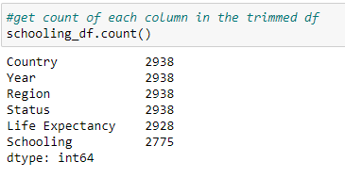
Data Cleaning cont.

Slide 5
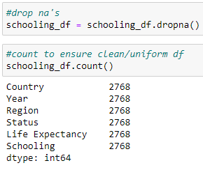
Data Cleaning cont.

Slide 6
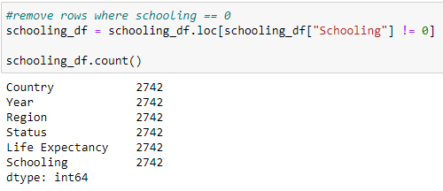
Data Cleaning cont.

Slide 7
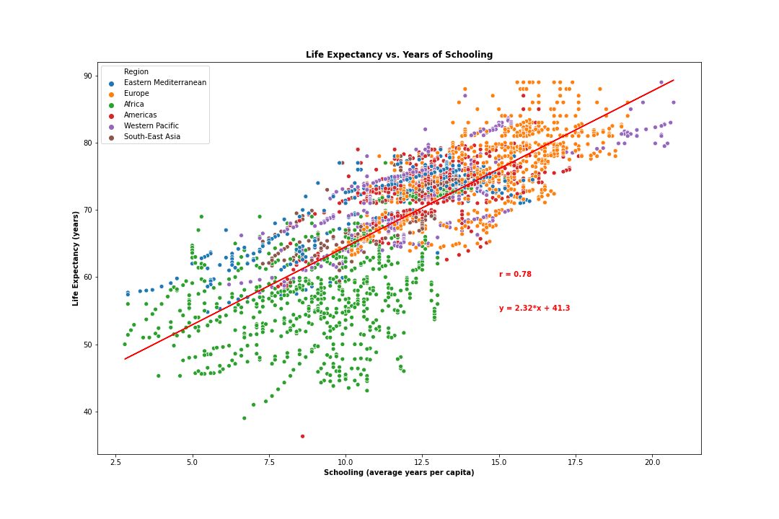
Life Expectancy vs. Schooling (Consolidated)
Notes:
This slide is looking at Life Expectancy vs. Years of Schooling consolidated (both Developing and Developed countries included in the dataset)
Correlation coefficient of .78 suggests strong correlation between a country’s education increases and increase in its life expectancy
Positive slope and positive correlation coefficient means a direct relationship which is what we would expect
Whether this is causation or simply correlation is unclear, to be investigated in the next couple slides (obviously causation cannot be implied unless there is a randomized controlled experiment, but we can conjecture about the possible relationship).

Slide 8
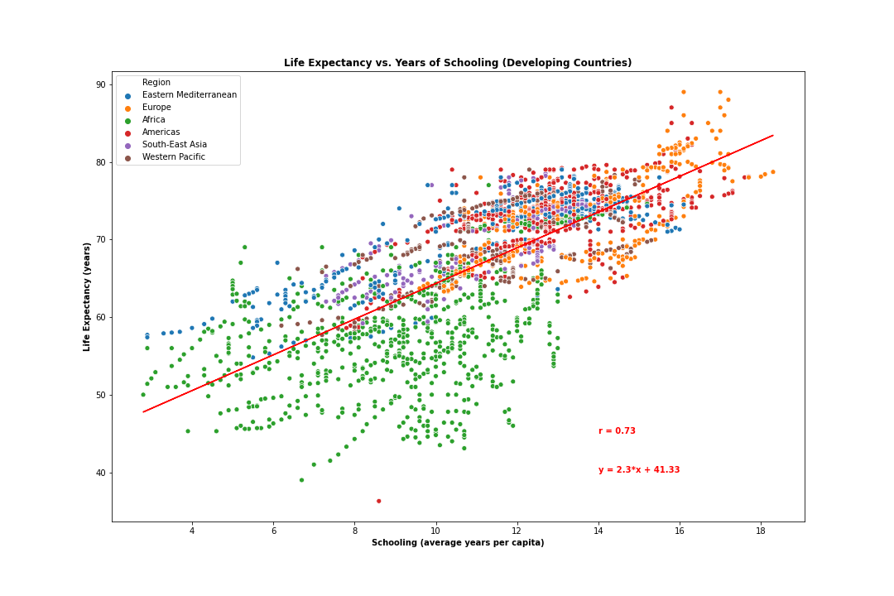
Life Expectancy vs. Schooling (Developing)
Notes:
This slide is looking at life expectancy vs schooling for Developing countries
Strong correlation coefficient and positive linear relationship
Potential confounding variables – as a country strives for development, education and health will improve independent of each other but both will show improvements over time, and thus show strong correlation. This is evident in the next graph, as Developed countries schooling and life expectancy showed a weak relationship, indicating that there is not causation between a countries increase in schooling and increase in life expectancy, but rather the strong correlation seen here is influenced by some confounding variable as Developing countries seek development.

Slide 9
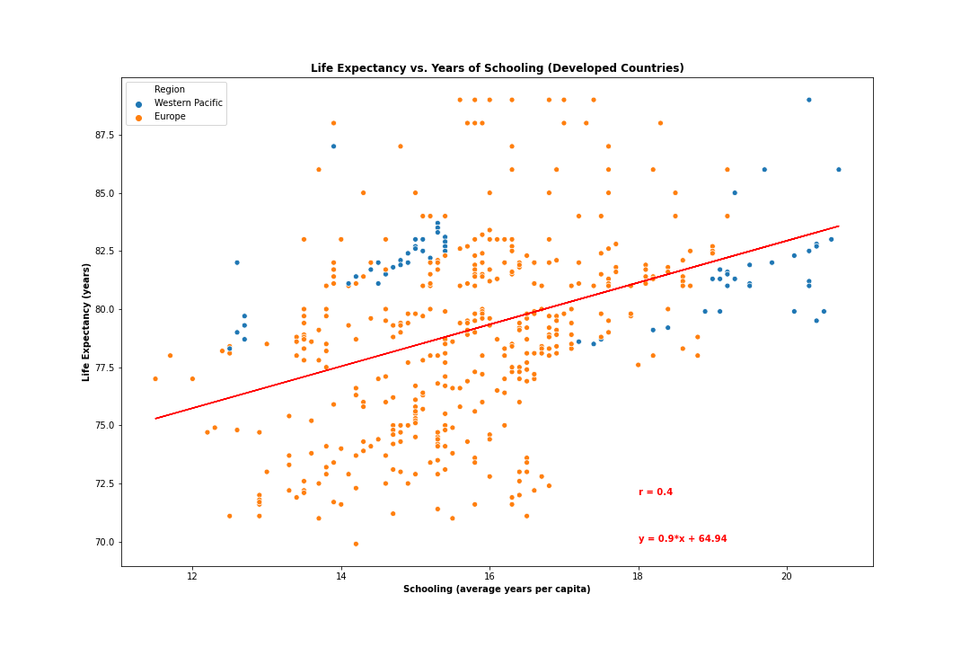
Life Expectancy vs. Schooling (Developed)
Notes:
This slide is looking at Life Expectancy vs. Education for Developed countries
Weak to moderate correlation coefficient of .4
Weak relationship because Developed countries already have strong education sectors. So, we see life expectancy increasing at a faster rate than schooling (as indicated by the individual slopes of life expectancy and education over time). The higher slopes for Life expectancy in the individual over time graphs also points to additional factors outside of schooling that would increase a country’s life expectancy. The Developed countries already have strong education systems in place, so the schooling will not increase as fast as life expectancy.

Slide 10
Conclusion: Life Expectancy vs. Schooling
Strong correlation overall and specifically for developing countries
Weak correlation for developed countries
Correlation not causation
Notes:
Based on the data analysis, we conclude that the relationship between a country’s schooling and its life expectancy is one of correlation rather than causation. This is driven by the face that there is a weak correlation coefficient between Life Expectancy and Schooling for developed countries. This indicates that the reason there is strong correlation between life expectancy and schooling for developing countries is because both variable are increasing independent of the other as a developing country becomes more developed in the 21st century. Countries will spend more on healthcare, vaccinations, and schooling and thus life expectancy and schooling will improve in congruence. However, I don’t believe there is a causal relationship.

